Slide 1


Artificial Intelligence in Finance
Artificial intelligence (AI) is transforming the financial services industry, offering powerful solutions to complex challenges.
by Jayesh Sharmila

Slide 2
Key Applications of AI in Finance
Fraud Detection
Investment Decisions
Predictive Analytics
Customer Service
AI algorithms can analyze large datasets to identify fraudulent transactions and patterns.
AI can analyze market trends and economic indicators to forecast future financial performance.
AI-powered chatbots can provide 24/7 customer support and personalize financial services.
AI-powered portfolio management tools can optimize investment strategies and generate personalized recommendations.

Slide 3




AI-Driven Fraud Detection and Prevention
Real-Time Monitoring
Pattern Recognition
AI systems can analyze transactions in real time, flagging suspicious activity.
AI can detect unusual patterns in spending habits and transaction data that may indicate fraud.
Enhanced Security
AI helps financial institutions strengthen security measures and prevent future fraud.

Slide 4



AI-Powered Portfolio Management and Investment Decisions
Personalized Recommendations
1
AI can tailor investment strategies to individual risk profiles and goals.
Automated Trading
2
AI algorithms can execute trades based on predefined parameters and market conditions.
Risk Management
3
AI can help assess and mitigate risks associated with investments.

Slide 5
Leveraging AI for Predictive Analytics and Forecasting
Market Trends
1
AI algorithms can identify patterns and trends in market data to forecast future movements.
Economic Indicators
2
AI can analyze economic indicators to predict economic growth or recession.
Risk Assessment
3
AI can help assess credit risk, market risk, and other financial risks.

Slide 6
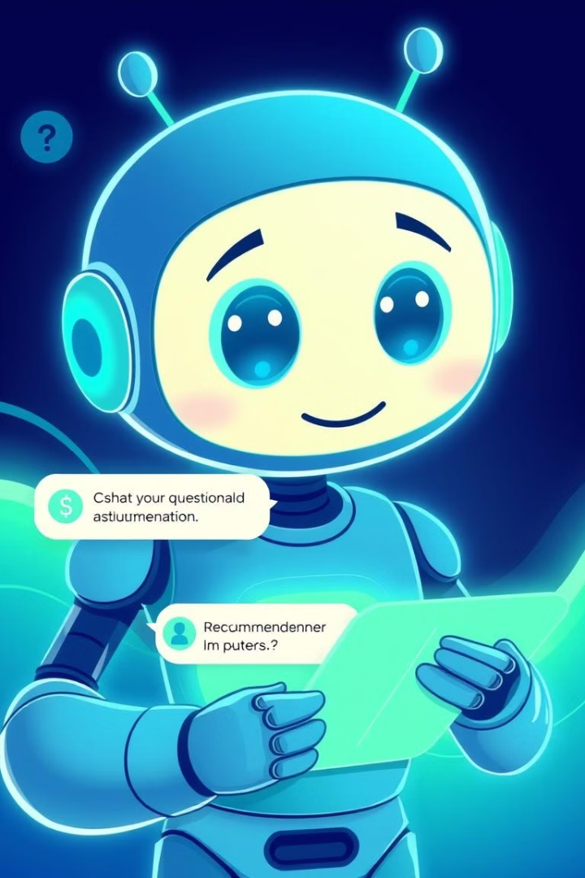
AI-Enabled Customer Service and Personalization
24/7 Availability
Personalized Recommendations
AI-powered chatbots can provide instant support to customers around the clock.
AI can analyze customer data to offer tailored financial products and services.
Enhanced Efficiency
AI chatbots can handle routine inquiries, freeing up human agents for more complex tasks.

Slide 7

Enhancing Risk Management with AI and Machine Learning
Fraud Detection
Credit Risk Assessment
Market Risk Management
AI can identify suspicious transactions and prevent financial losses.
AI can analyze creditworthiness to make informed lending decisions.
AI can help mitigate market risks by predicting and managing market volatility.

Slide 8





Ethical Considerations and Regulatory Implications of AI in Finance
Data Privacy
AI systems require access to sensitive financial data, raising privacy concerns.
Algorithmic Bias
AI algorithms can perpetuate biases present in the data they are trained on.
Transparency and Explainability
It is crucial to understand how AI systems reach their conclusions and ensure transparency.
Regulatory Oversight
Governments are developing regulations to ensure responsible use of AI in finance.

Slide 9

Overcoming Challenges and Barriers to AI Adoption in Finance
1
2
Data Quality
Talent Gap
AI systems require clean and accurate data for optimal performance.
There is a need for skilled professionals to develop, deploy, and manage AI systems.
3
Cost of Implementation
Developing and deploying AI systems can be expensive, requiring significant investments.

Slide 10

The Future of AI in the Financial Services Industry
AI will continue to shape the financial services industry, driving innovation, efficiency, and personalized experiences.

